Slide 1
Ch8. Motor control 2 ( Stepper motor )
1) Stepper Motor control
1-1) Bipolar with L293D
1-2) Unipolar with ULN2003
2) Bipolar stepper with A4988
3) Bipolar stepper with TB6600
4) Temp/Humidity sensor
4-1) dht11 library
4-2) simple DHT library
Ch9. Serial Interface
1) UART
2) I2C

Slide 2

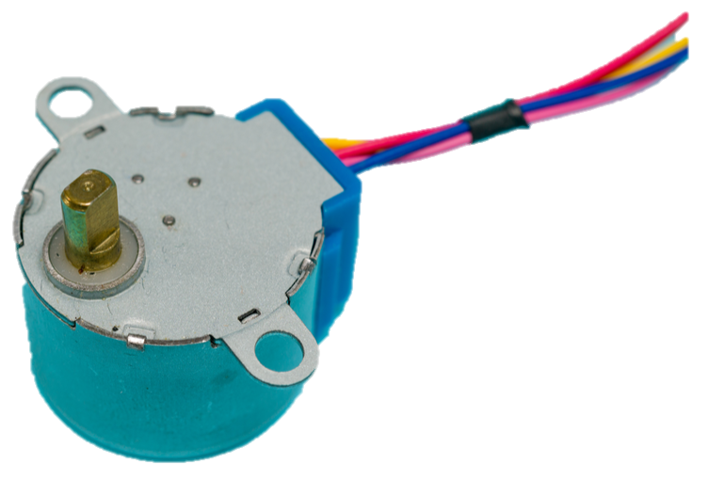
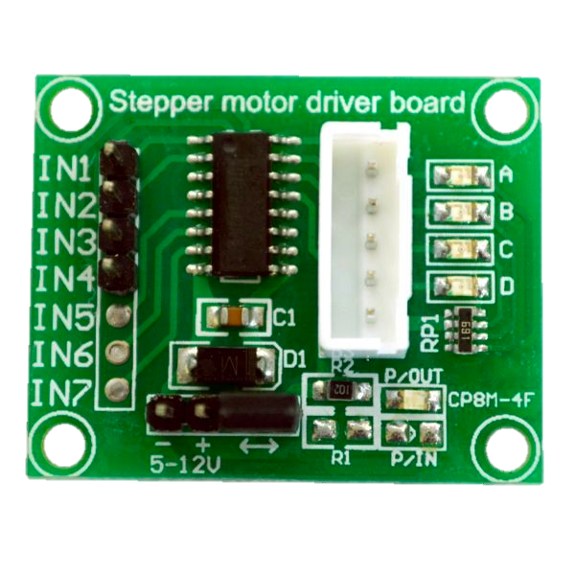
Stepper Motor control
프로젝트 : 스테퍼 모터 컨트롤
목적 : 스테퍼 모터 이해, 유니폴라와 바이폴라 차이점
준비물 :
아두이노 우노 1 개
브래드보드 1개
스텝모터 1개
베터리 6 V
점퍼케이블

Slide 3
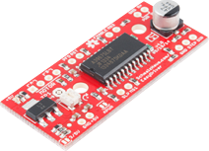
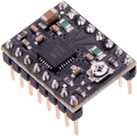
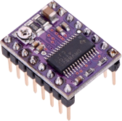
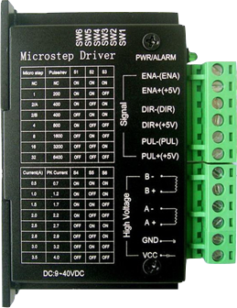
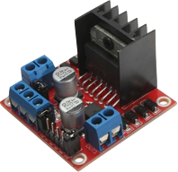
1) Stepper motor control
Popular Stepper Motor drivers
DRV8825
Easy driver
A4988
AF Motor shield
L298N
TB6600

Slide 4
Stepper motor
Unipolar
Bipolar
4
4
3
3
1
2
1
2

Slide 5

1) Stepper motor control
Unipolar and Bipolar Stepper Motor
S
N
S
N
N
S
4
1
3
2
4
3
2
1
+ 5V
Unipolar
Bipolar

Slide 6
1) Stepper motor control
Step driving method
Wave Drive :
one phase/time
simple
but small torque
Full Step :
two phase/time
double torque
but less precise than half step
Half Step :
one then two phase in turn
double precision
but less torque than full step
Wave Drive
Full Step
Half Step

Slide 7
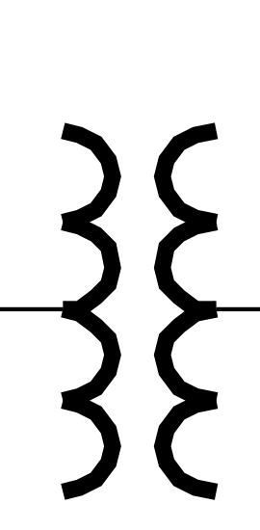



1-1) Bipolar with L293D
아두이노 8
아두이노 11
아두이노 9
+5V
+5V
아두이노 10
1
2
3
4
5
6
7
8
16
15
14
13
12
11
10
9
L 293D
배터리+V
+5V
+
-
아두이노 5V
배터리
스텝모터
배터리+V
아두이노 GND 와 배터리 -
L293D Bipolar Stepper control

Slide 8
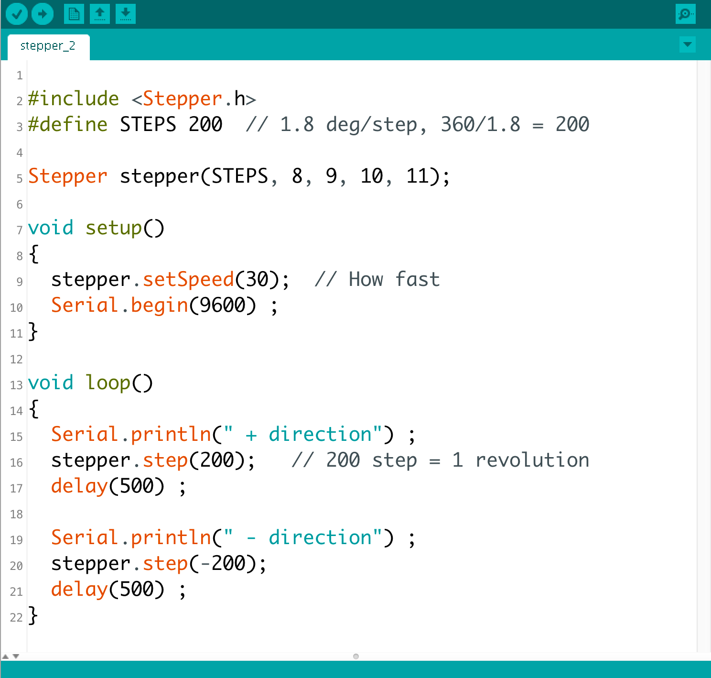
1) Stepper motor control

Slide 9
1-2) Unipolar with ULN2003
8
IN1
IN2
IN3
IN4
9
10
11
ULN2003A Unipolar Stepper Motor Driver

Slide 10
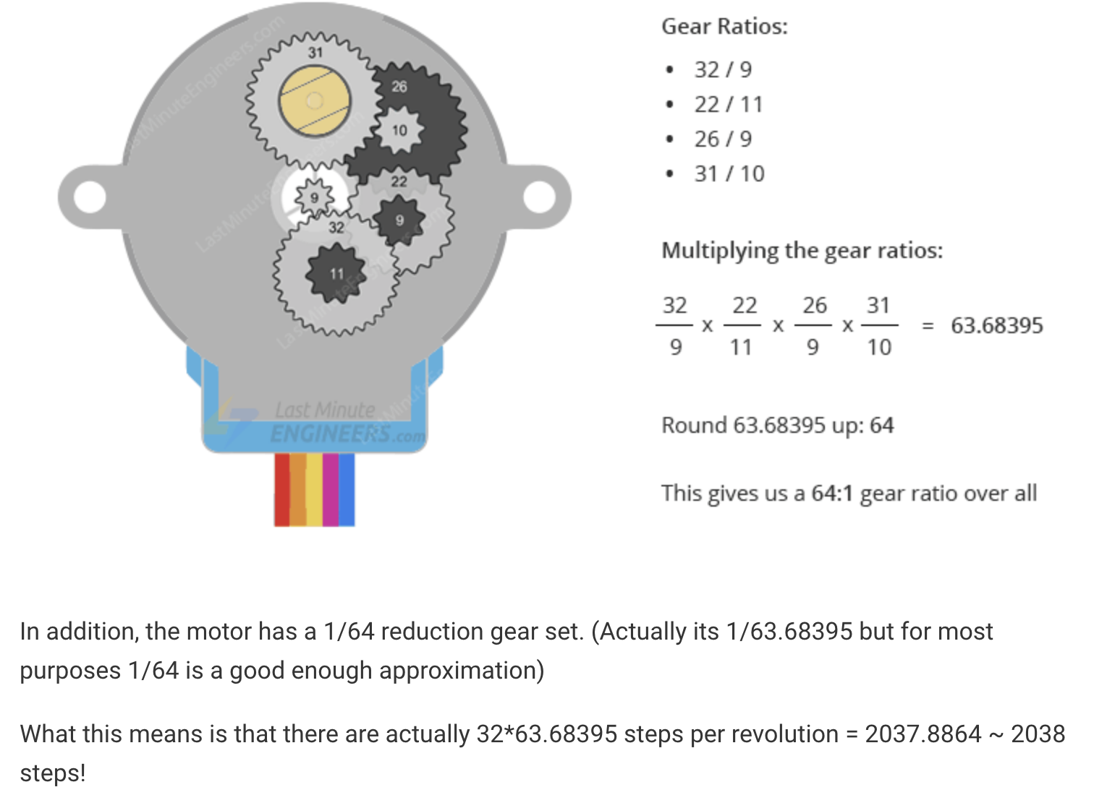

Slide 11
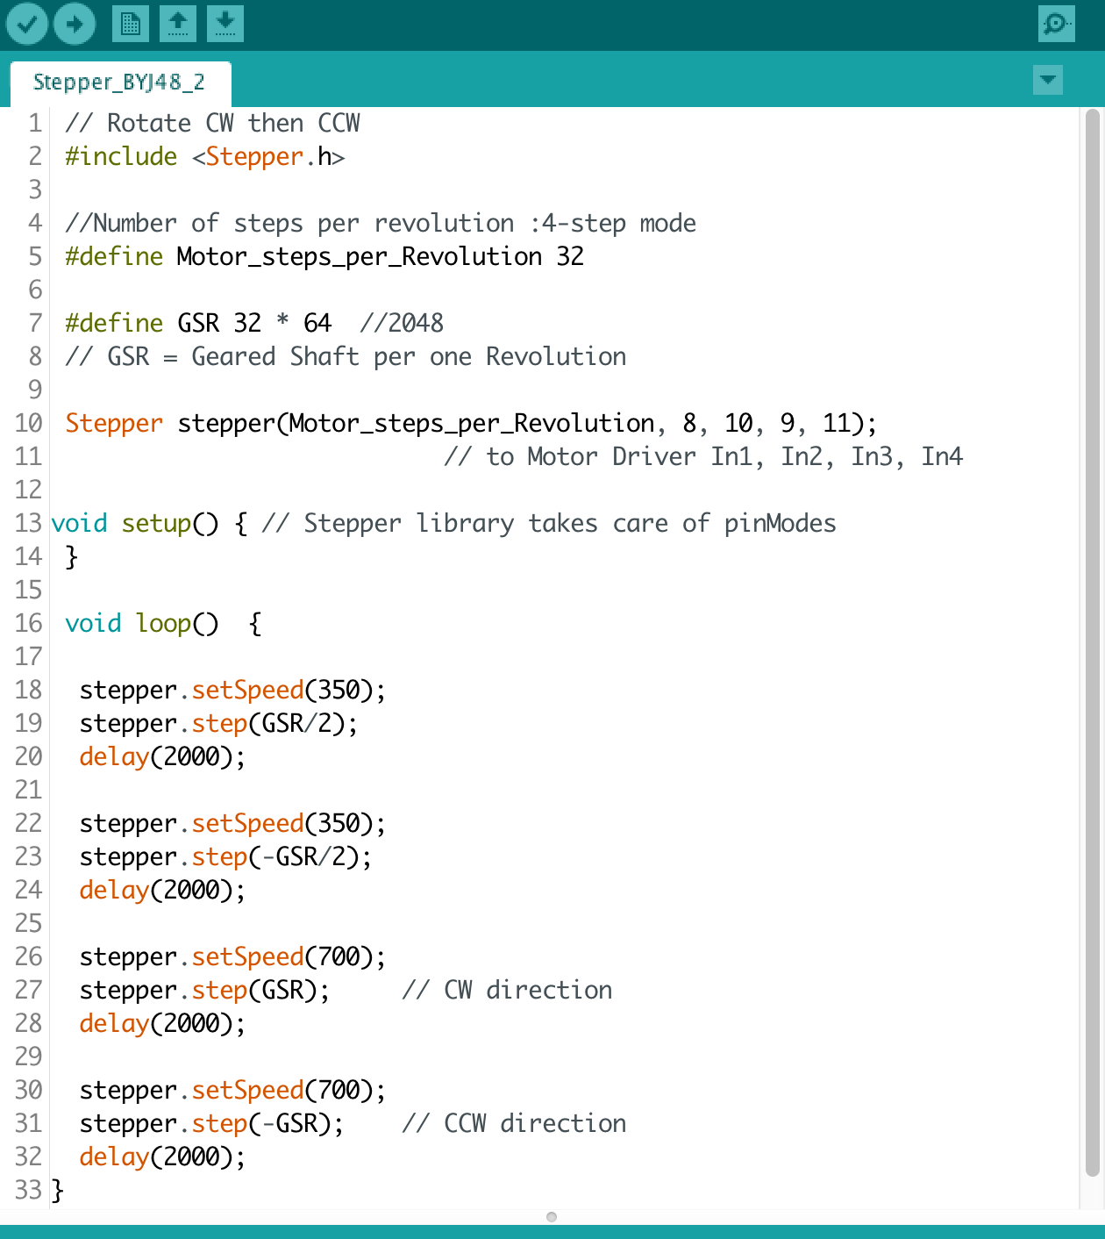
1-2) Unipolar with ULN2003

Slide 12
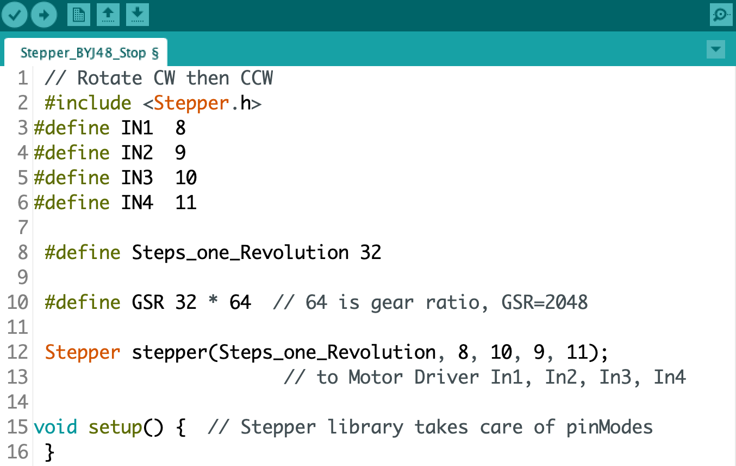
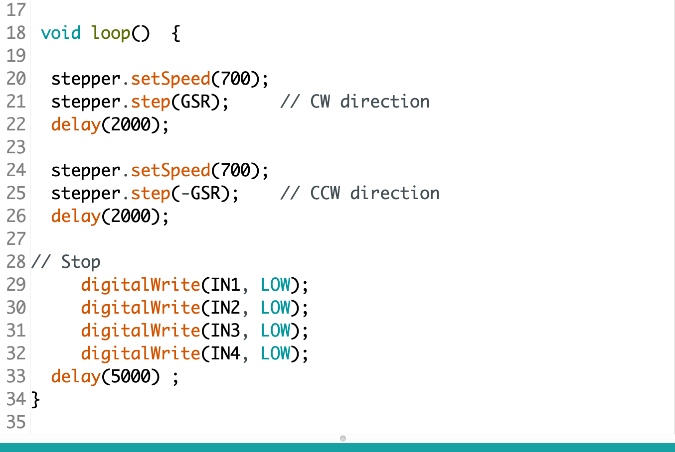
Unipolar ULN2003 STOP

Slide 13
1-2) Unipolar with ULN2003
Unipolar Sketch
Bipolar Sketch

Slide 14
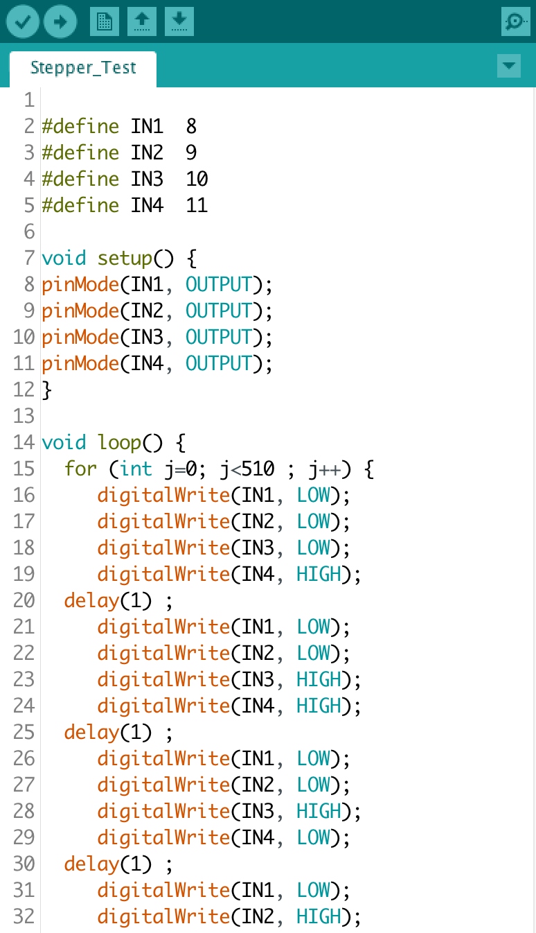
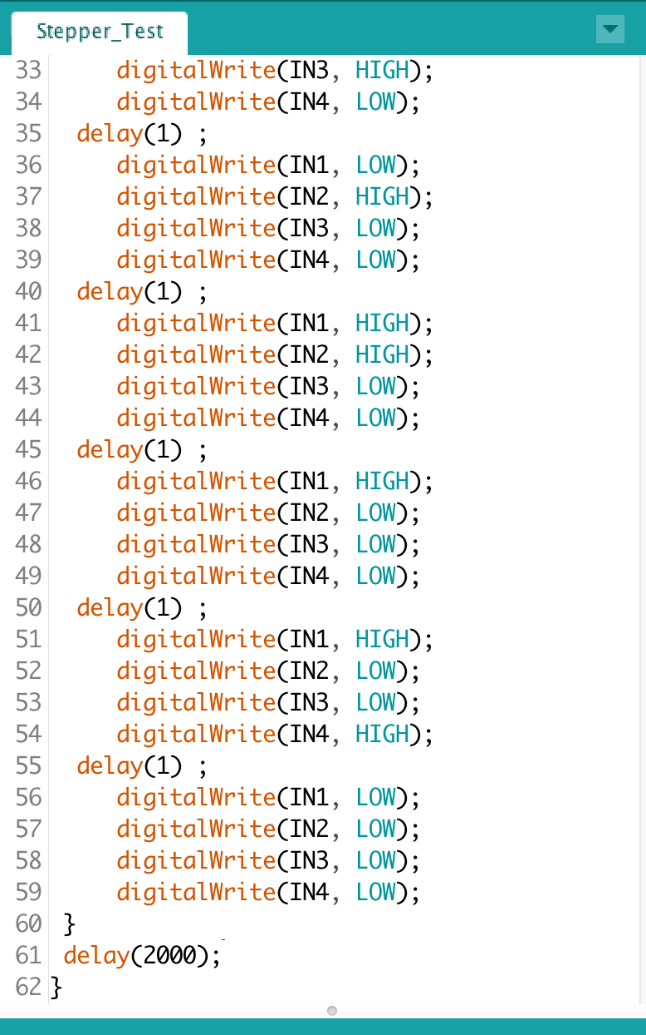
1-2) Unipolar with ULN2003
Unipolar stepper motor
without library

Slide 15
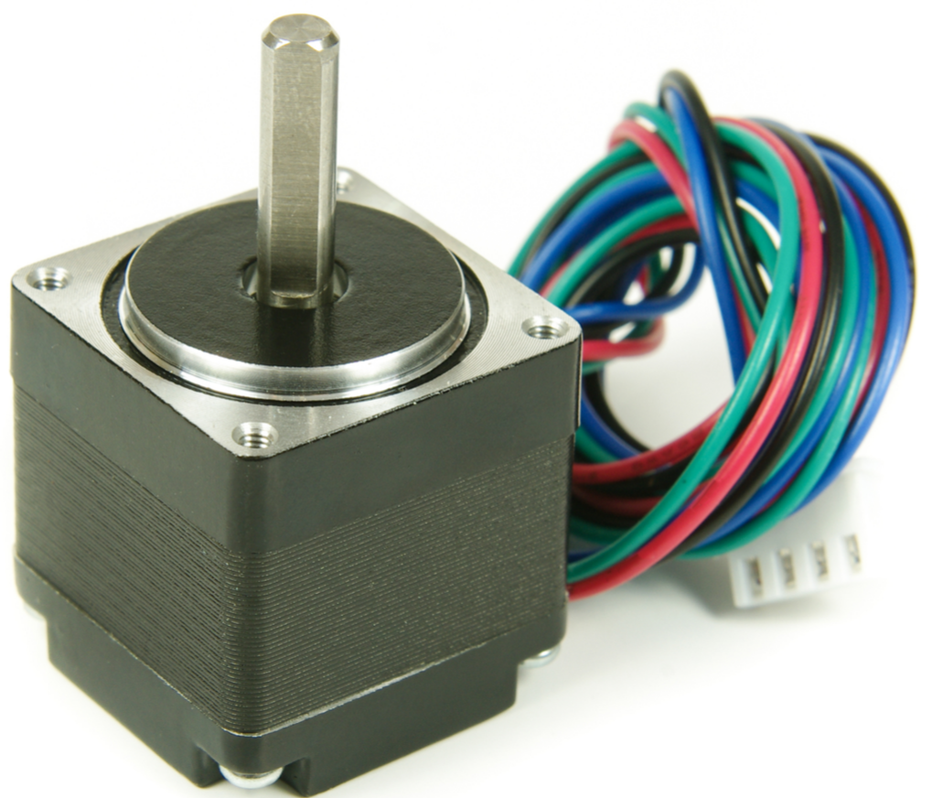
Bipolar 스텝 모터 with A4988
A4988

Slide 16
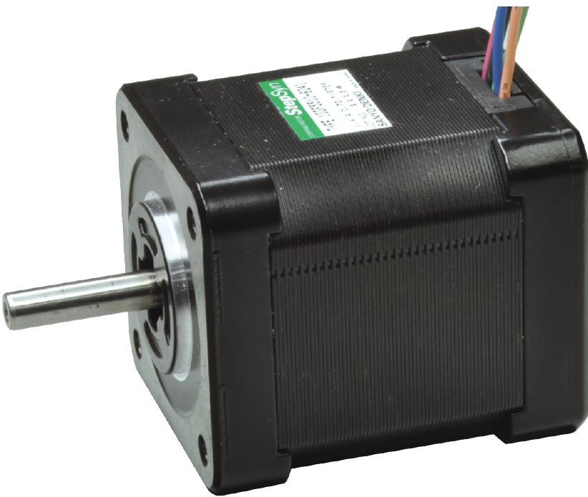
NEMA ..
NEMA 17
NEMA 23
NEMA ..
North American standard for Electric motors

Slide 17


Slide 18
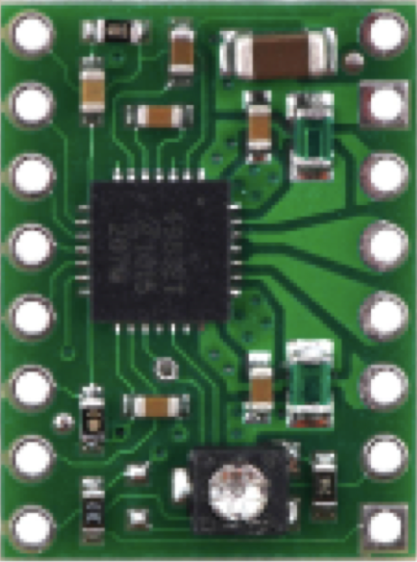
2) Bipolar with A4988
EN
MS1
MS2
MS3
Reset
Sleep
Step
DIR
VMOT
GND
2B
2A
1A
1B
VDD
GND
A4988
모터 : Bipolar 스텝 모터
MS1 MS2 MS3 Microstep Resolution
Low Low Low Full step
High Low Low Half step
Low High Low Quarter step
High High Low Eighth step
High High High Sixteenth step

Slide 19
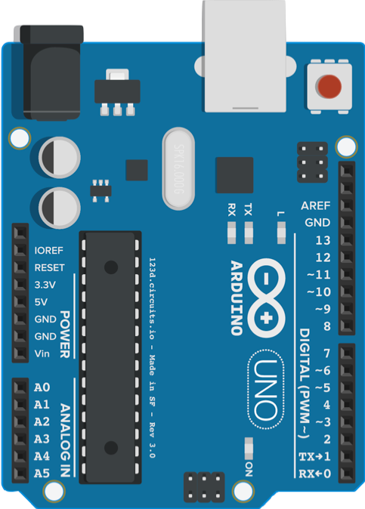
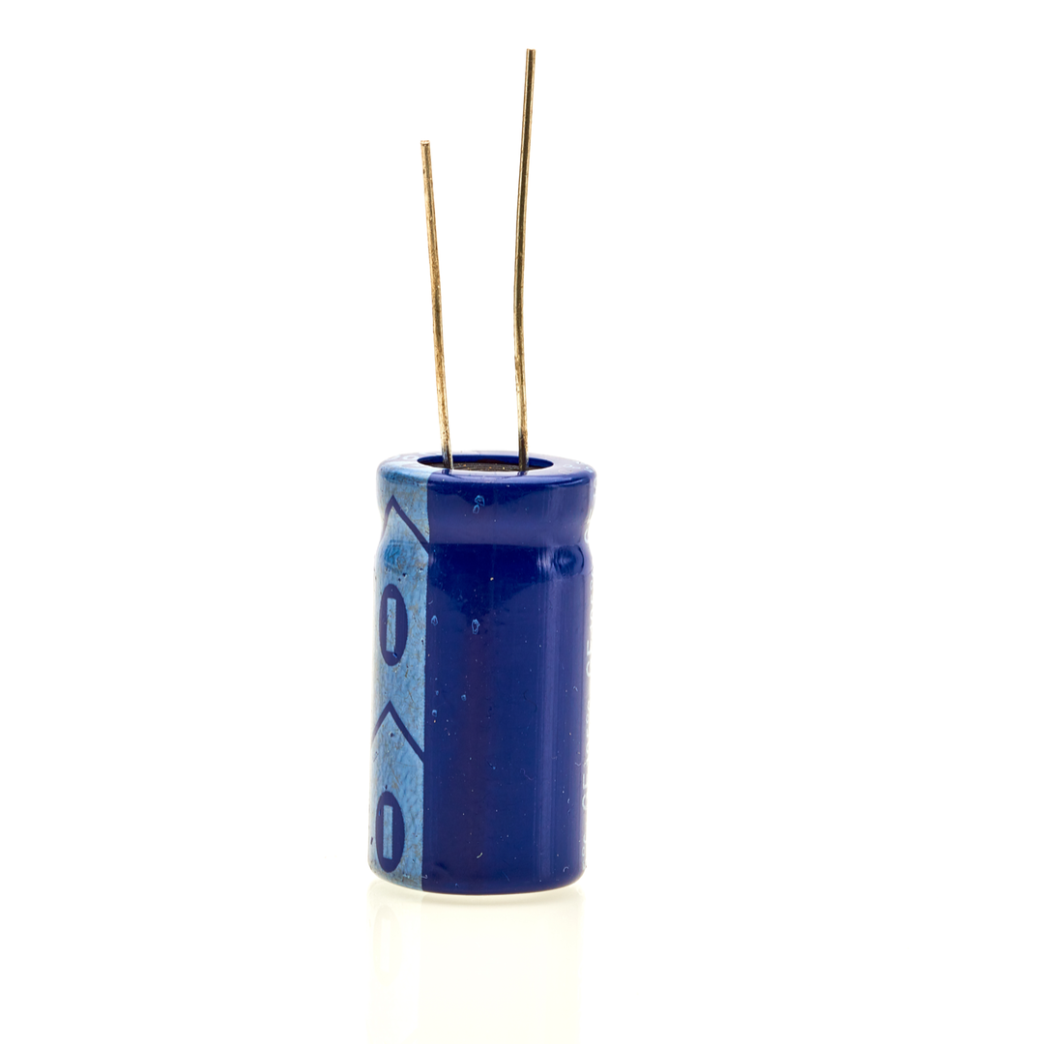

2) Bipolar with A4988
Circuit
100 µF
EN
MS1
MS2
MS3
Reset
Sleep
Step
DIR
VMOT
GND
2B
2A
1A
1B
VDD
GND

Slide 20
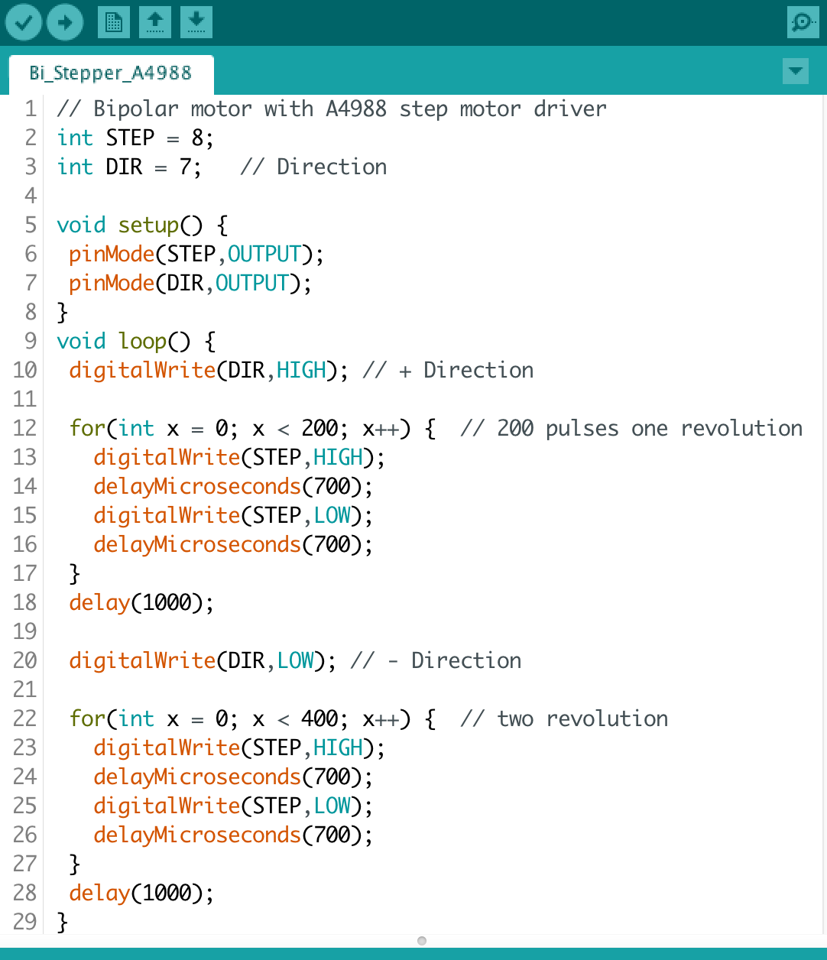
2) Bipolar with A4988
delayMicroseconds( )
시간 변경 필요

Slide 21


2) Bipolar with A4988
Same Pinout
A4988
DRV8825

Slide 22
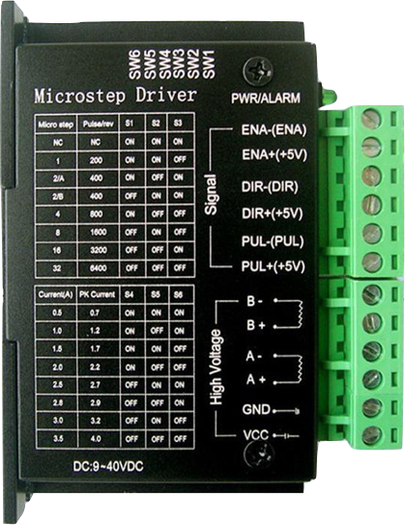
3) Bipolar with TB6600
Bipolar 스텝 모터 with TB6600

Slide 23
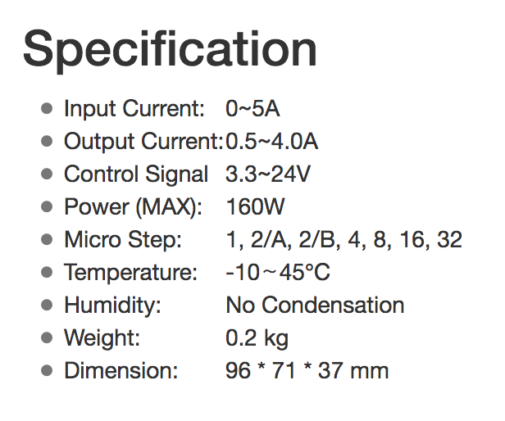
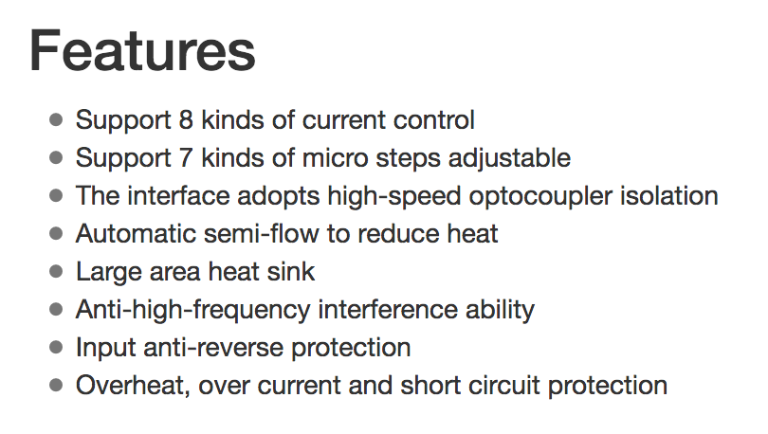
3) Bipolar with TB6600
TB6600 stepper motor driver

Slide 24
3) Bipolar with TB6600
EN+
EN-
PULL+
PULL-
DIR+
DIR-
B-
B+
A-
A+
GND
VCC
TB6600
Arduino
8
9
10
11
Stepper
motor
GND
VCC
AC
Power supply

Slide 25
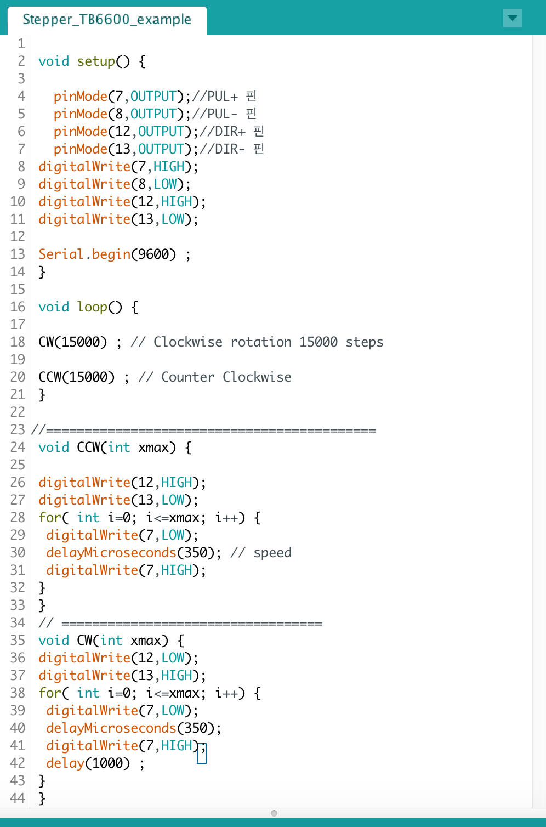
3) Bipolar with TB6600

